Slide 1
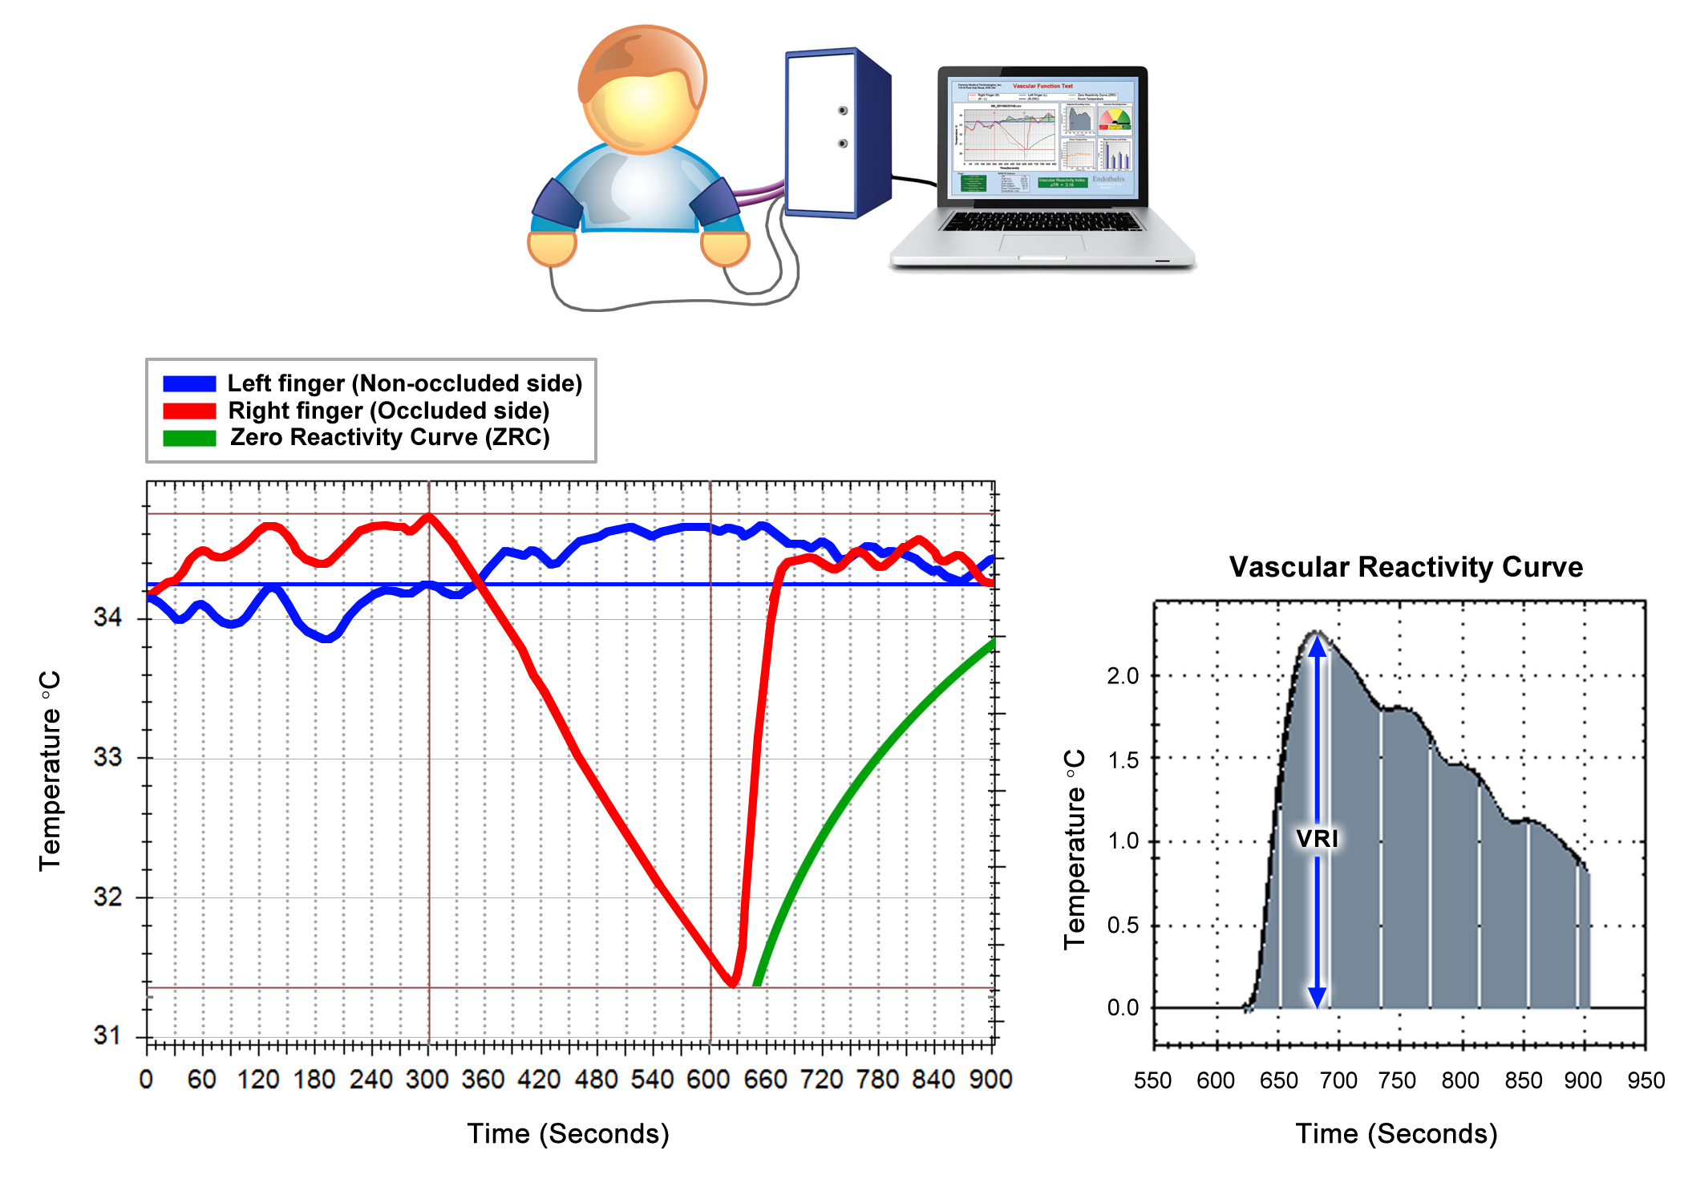
1
Figure 1: Patient Setup and Sample VENDYS DTM Report
(Above) Illustration of patient setup, with temperature sensors affixed to both index fingers and blood pressure cuffs on both arms.
(Below left) A sample report screen displays a right finger temperature curve (red), a left finger temperature curve (blue), and a Zero Reactivity Curve (green).
(Below right) The software-generated, vascular reactivity curve is shown. The vascular reactivity index (VRI) is taken as the maximum value of this temperature curve during the reactive hyperemic period.

Slide 2
2A
Figure 2A: Distribution of Vascular Reactivity Index (VRI)
A histogram and cumulative percentage curve are shown.

Slide 3
2B
Women
Men
≥ 2
Figure 2B: Distribution of Vascular Reactivity Index (VRI) by Gender
The percent of DTM tests falling into categories of poor, intermediate, and good vascular reactivity is shown for men (solid fill) and women (hatch fill).

Slide 4
3
Figure 2C: Vascular Reactivity Index (VRI) and Age
A scatter plot, trend line, and Pearson’s r coefficient are shown. VRI was mildly and inversely correlated with age.

Slide 5
4A
≥ 70
Figure 2D: Prevalence of Poor VRI in Different Age Groups
The frequency of having a poor VRI score (VRI <1.0) is shown for the three age categories of age < 50y, age 50-70y, and age >=70y.

Slide 6
4B
Figure 2E: Distribution of Vascular Reactivity Index (VRI) in Oldest Age Group
The percent of tests falling into categories of poor, intermediate, and good vascular reactivity is shown for patients age >= 70 years.

Slide 7
Table 1: Selected Patient and Test Characteristics
Variable | Mean ± SD or %(n) | Variable | Mean ± SD or %
Age (y) | 65.5 ± 13.7 | Cold Finger | 5.8% (n=353)
Male / Female | 54% / 46% | Sympathetic Response | 4.8% (n=294)
Systolic blood pressure (mmHg) | 138 ± 20 | VRI score, overall | 1.53 ± 0.53
Diastolic blood pressure (mmHg) | 77 ± 12 | VRI score, women | 1.56 ± 0.58
Heart rate (bpm) | 70 ± 13 | VRI score, men | 1.50 ± 0.49
Right finger t300 (°C) | 32.1 ± 2.7
Left finger t300 (°C) | 31.9 ± 2.8
Ambient temperature (°C) | 24.3 ± 1.9
Table 1: Selected Patient and Test Characteristics
Finger t300 = finger temperature at the onset of cuff occlusion (time300s); VRI = vascular reactivity index; NVRI = neurovascular reactivity index; Cold Finger = a flagged condition in which right finger t300 is equal to or less than 27°C; Sympathetic Response = a flagged condition in which left finger temperature continuously declines after right arm cuff occlusion

Slide 8
Table 2: Multiple Linear Regression – Models for VRI, SBP, and DBP
VRI (Dependent) R Square = 0.06, SE = 0.52 | β | p-value
Intercept | 1.885539 | < 0.001
Age | -0.00826 | < 0.001
DBP | 0.003341 | 0.002
Male sex | -0.09741 | < 0.001
SBP (Dependent) R Square = 0.02, SE = 20.36 | β | p-value
Intercept | 119.3615425 | < 0.001
VRI | 2.304075346 | 0.001
Age | 0.186886935 | < 0.001
HR | 0.067271865 | 0.018
Male sex | -0.412960283 | 0.560
DBP (Dependent) R Square = 0.10, SE = 11.78 | β | p-value
Intercept | 70.26680855 | < 0.001
VRI | 1.796063985 | < 0.001
Age | -0.150770023 | < 0.001
HR | 0.1759533 | < 0.001
Male sex | 3.509046088 | < 0.001
Results are shown for four separate multiple linear regression models: VRI (vascular reactivity index), SBP (systolic blood pressure) and DBP (diastolic blood pressure). β = β coefficient; R Square = R2; SE = standard error. Units for variables were as follows: Age (y), HR (bpm), Sex (male = 1, female = 0), SBP and DBP (mm Hg).

Slide 9
Table 3: Comparison between CVD Risk Assessment Methods
Method | Type (Structural, Functional, Risk Factors) | Independent of Age | Predictive Value | Response to Therapy | Ease of Use and Applicability in Primary Care Setting | Intra- and Inter -Observer Reproducibility | Self-Monitoring by Patients at Home
Coronary Artery Calcium | Structural | - | +++ | - | + | +++ | -
Carotid IMT and Plaque | Structural | - | ++ | + | ++ | + | -
Ankle Brachial Index | Structural | - | ++ | - | +++ | ++ | -
Arterial Stiffness (e.g., PWV, AI, C1/C2) | Structural/ Functional | - | ++ | + | ++ | ++ | -
Risk Factor-Based Risk Calculators (e.g.,FRS, SCORE, QRISK2) | Risk Factors | - | ++ | n/a | +++ | ++ | ++
FMD | Functional | + | ++ | ++ | - | - | -
PAT (RHI) | Functional | + | ++ | ++ | +++ | ++ | ++
PPG (RI) | Functional | + | ++ | ++ | +++ | ++ | ++
DTM (VRI) | Functional | + | ++ | ++ | +++ | ++ | +++
Table 3: Comparison between CVD Risk Assessment Methods
Carotid IMT = carotid intima-media thickness; PWV = pulse wave velocity; AI = augmentation index; C1/C2 = indices of large and small artery compliance (elasticity); FRS = Framingham Risk Score; SCORE = Systematic Coronary Risk Evaluation risk score system published by The European Society of Cardiology; QRISK2 = risk calculator developed by UK National Health Service; FMD = flow mediated dilatation; PAT = peripheral arterial tonometry; RHI = reactive hyperemia index; PPG = photoplethysmography for digital pulse waveform analysis; RI = reflection index; DTM = digital thermal monitoring; VRI = vascular reactivity

Slide 10
Burrowed from
Circulation Journal
Official Journal of the Japanese Circulation Society
http://www.j-circ.or.jp
Secondary Prevention Strategy of Cardiovascular Disease
Using Endothelial Function Testing
Yasushi Matsuzawa, MD, PhD; Raviteja R. Guddeti, MD; Taek-Geun

Slide 11
